Slide 1
Team Cristiano_Ronaldo
Bhashamul Bengali Regional IPA Transcription: A Comprehensive Byte T5 Based Approach
Abrar Jahin Niloy
Dept.of EEE
BUET
Email: abrarjahin.niloy@gmail.com

Slide 2
Presentation Overview
Introduction
IPA
Problem Statement
Dataset Analysis
Methodology
Model
Training Parameter
Results
Insights
Data pre-processing
Drawbacks
Conclusion

Slide 3
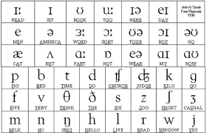
Introduction
What is IPA?
An alphabetic system of phonetic notation
Allows everyone to learn the pronunciation
Standardize the representation of spoken language

Slide 4
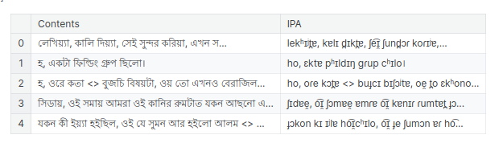
Introduction
Problem Statement
Bangla Text To IPA

Slide 5
Dataset Analysis
Words:
Unique words in training data: 29150
Unique words in test data: 10568
OOV words: 5001
English alphabet and numbers:
Ignored in IPA transcription
Bengali numerals:
Both Training and test sets contain 2 Bangla numerals.

Slide 6
Methodology
Model Selection Criteria:
Multilingual
Text2Text generation
Selected Model:
MT5-small
UMT5-base
ByT5-small
Bangla-T5

Slide 7
Methodology
Pretune and Fine tuning:
First, pre-train all the model using the 'DataVerse Challenge - ITVerse 2023' competition dataset. Use the model checkpoint to finetune on this competition dataset.
Training Parameter:
Total 10-15 epoch
Learning rate 3e-4
warmup_steps = 1000 , weight_decay = 1e-2
Batch size 4-8.

Slide 8
Methodology
Pre processing on Test Set:
Sort By Length
Removing English Alphabets
Adding Period at the end of those texts not having periods or ‘|’
Post processing on Test Set:
Remove period from the end of those ipas in which texts period were added in
preprocess 3

Slide 9
Results
All Models Pre-trained on Dataverse Dataset
Model | Epoch | Batch Size | Validation Loss | WER
MT5-small | 10 | 4 | 0.030469 | 0.105914
ByT5-small | 10 | 4 | 0.016217 | 0.01914
UMT5-small | 15 | 4 | 0.014737 | 0.028172
Bangla-t5 | 10 | 4 | 0.1347 | 0.9345

Slide 10
Results
Best Model:
→ByT5 - Small
→Public Score: 0.0188
→Private Score: 0.01898

Slide 11
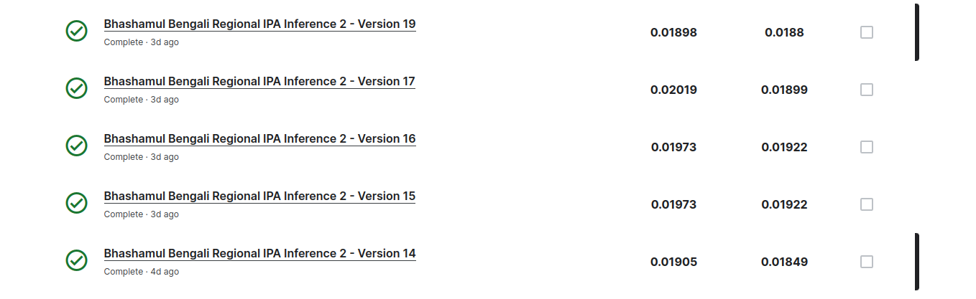
Insights
Drawbacks:
→ Absence of bangla numerals ipa in the training data set

Slide 12
Future Work
Pre train all the model in large scale dataset for less WER.
Try More different Models
Encoder-only model BERT

Slide 13
Thank You

